Slide 1

Customer Segmentation Analysis and Suggestions
Presented by Team 8:
Nathaniel Z, Youyi F, Xiaoya W, Xujuan L
Univ. of Cali Riverside

Slide 2



Background of this Analysis

Slide 3
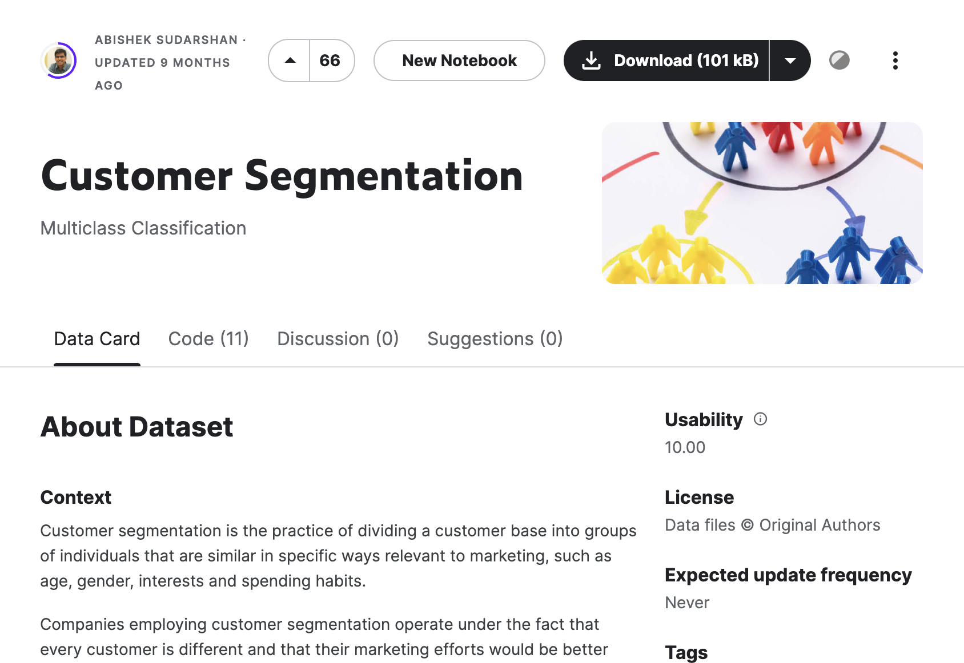
Where data is from? Kaggle Data

Slide 4
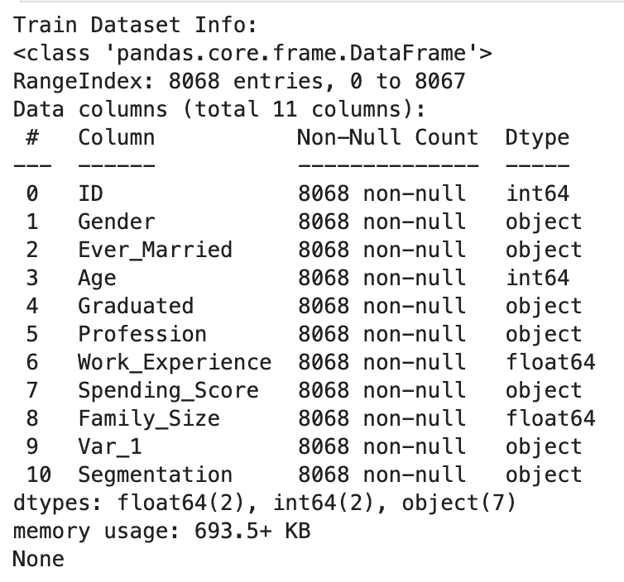
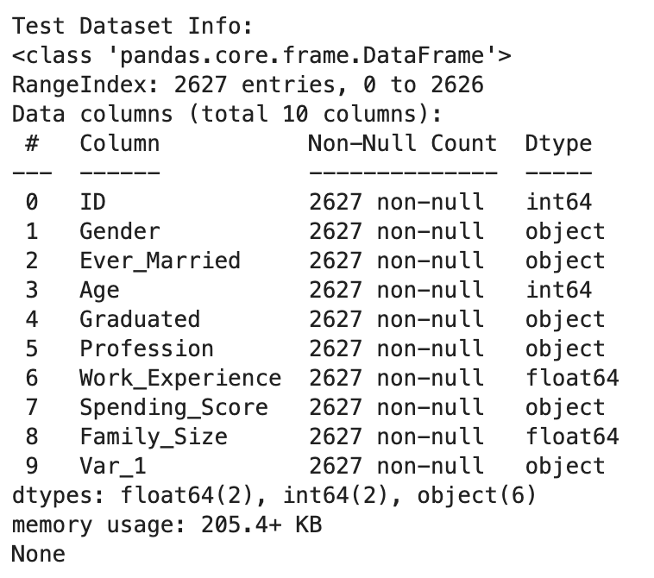
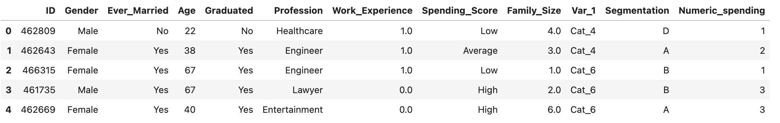
Introduction to Dataset

Slide 5

Section II: Descriptive Analysis

Slide 6
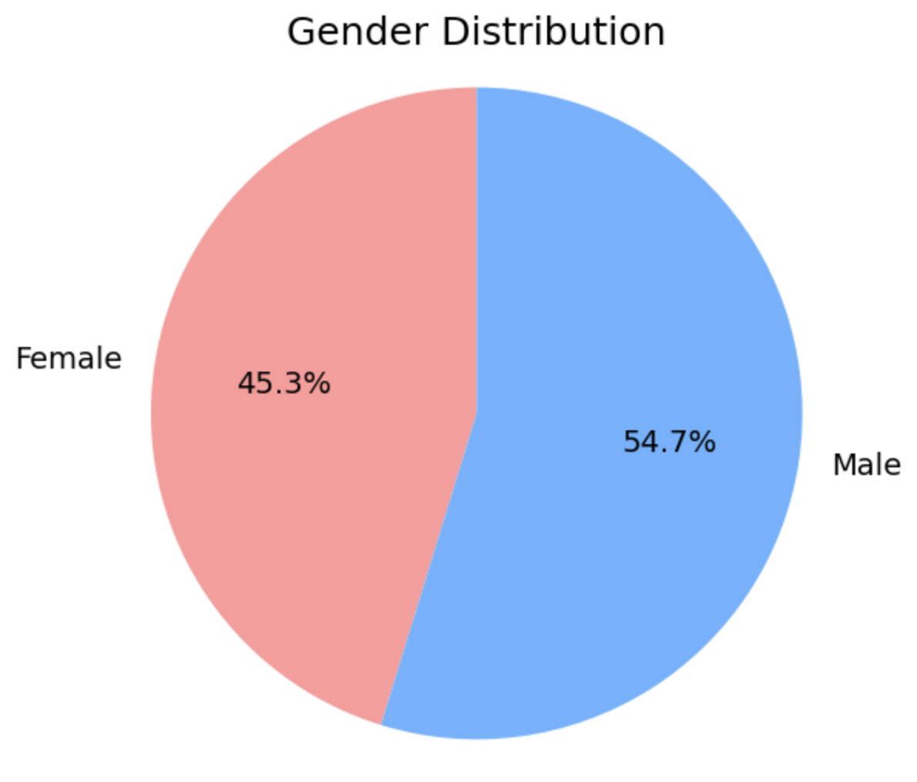
Section II: Descriptive Analysis:
Gender Distribution
The dataset contains records from 8,068 respondents, consisting of 3,651 females and 4,417 males. The gender distribution was visualized using a pie chart, illustrating a slightly higher proportion of male respondents (54.7%) compared to female respondents (45.3%).

Slide 7
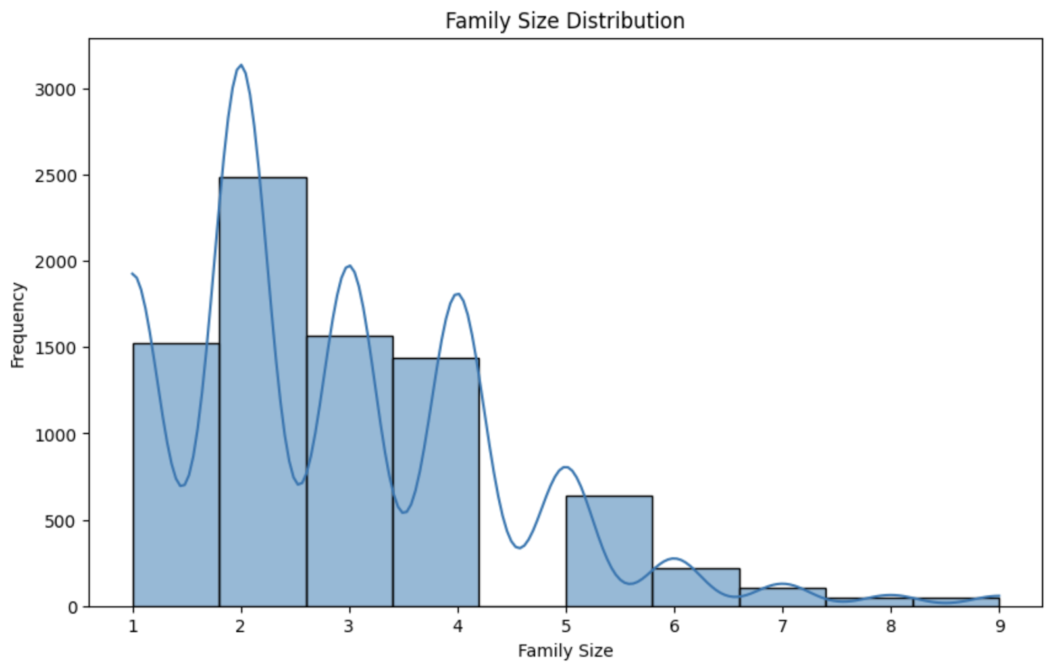
Section II: Descriptive Analysis:
Family Size Distribution
We analyzed the family size distribution which showed a continuous variable with a wide range of values. The histogram with a kernel density estimate (KDE) overlay provided insights into the commonality of different family sizes, highlighting a mode at smaller family sizes.

Slide 8
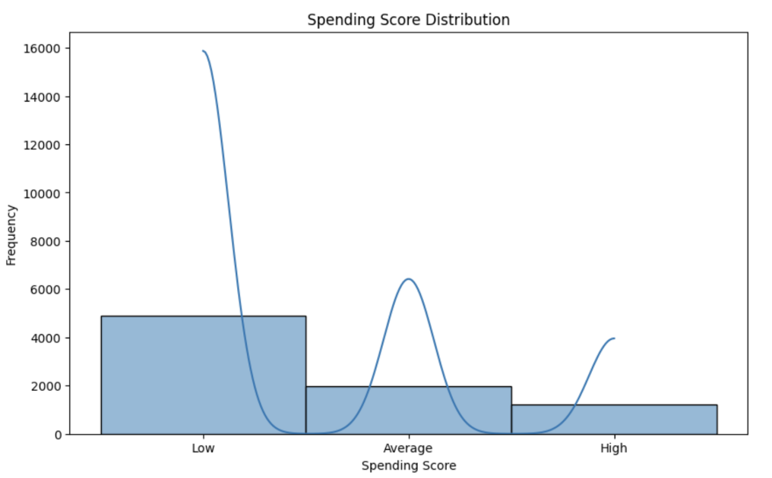
Section II: Descriptive Analysis:
Spending Score Distribution
The distribution of spending scores was detailed through a histogram, indicating three distinct groups categorized as low, average, and high spenders. This visualization was integral in understanding the spending behaviors associated with different demographic groups.

Slide 9
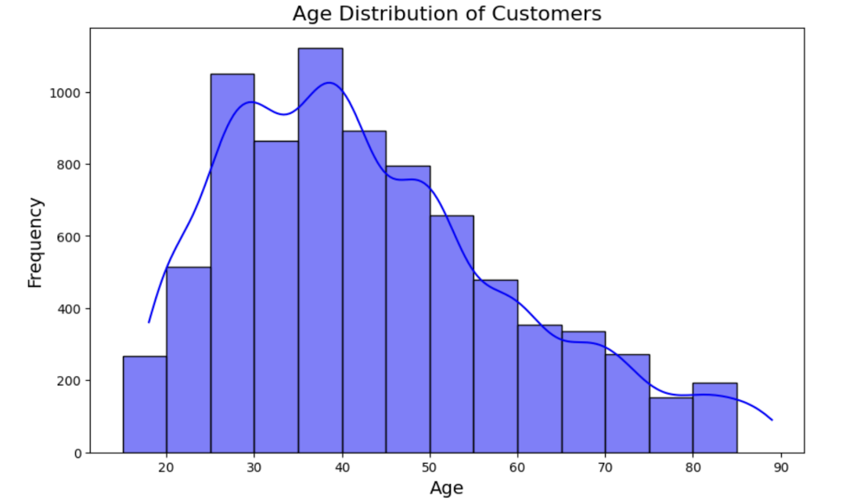
Section II: Descriptive Analysis:
Age Distribution
Age data was visualized using a histogram segmented into five-year intervals, which helped in identifying the age groups most prevalent in our dataset. The KDE showed a bimodal distribution, suggesting two major age groups within our respondents.

Slide 10
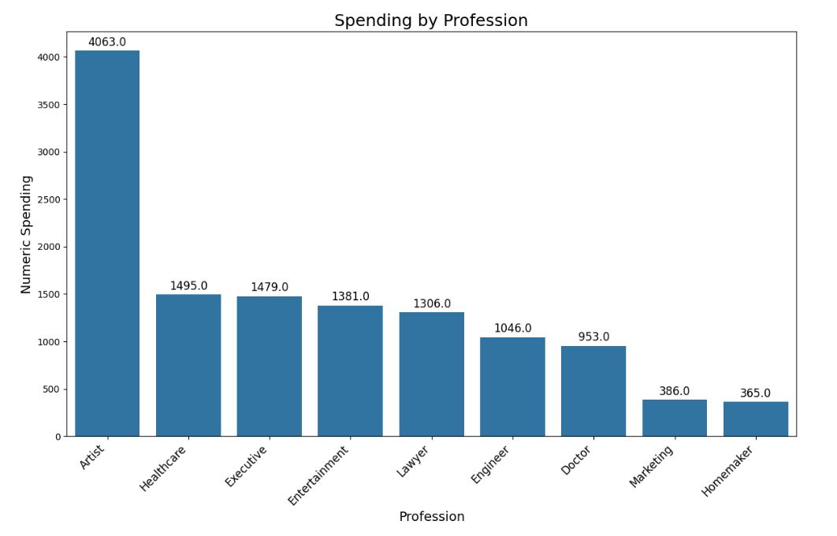
Section II: Descriptive Analysis:
Spending Power by Profession
An analysis of spending power segmented by profession revealed significant variance among different occupational groups. Artists and healthcare professionals showed the highest and second-highest spending scores respectively, offering insights into economic behaviors by profession.

Slide 11
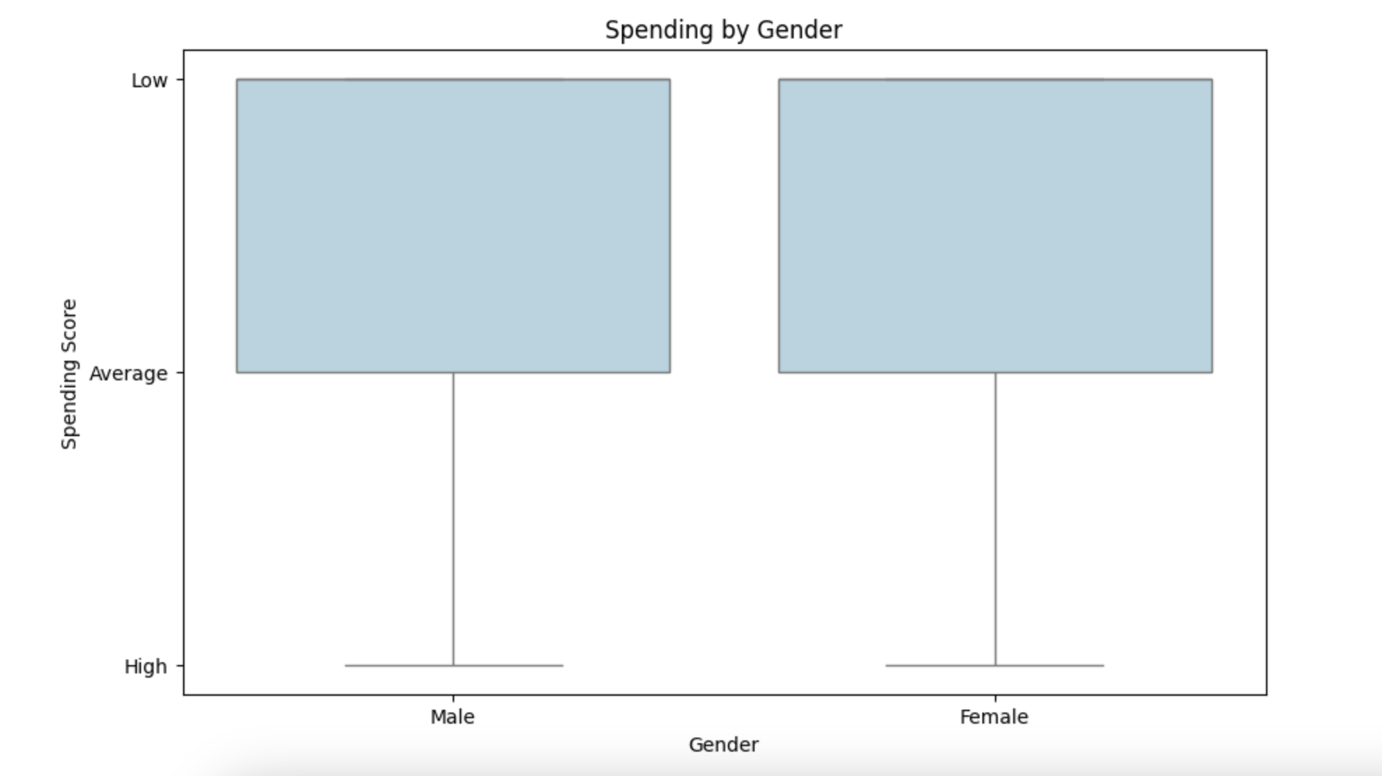
Section II: Descriptive Analysis:
Spending by Gender
The chart shows spending scores for males and females across low, average, and high categories using box plots. This visual representation allows for a comparison of spending behaviors between genders.

Slide 12
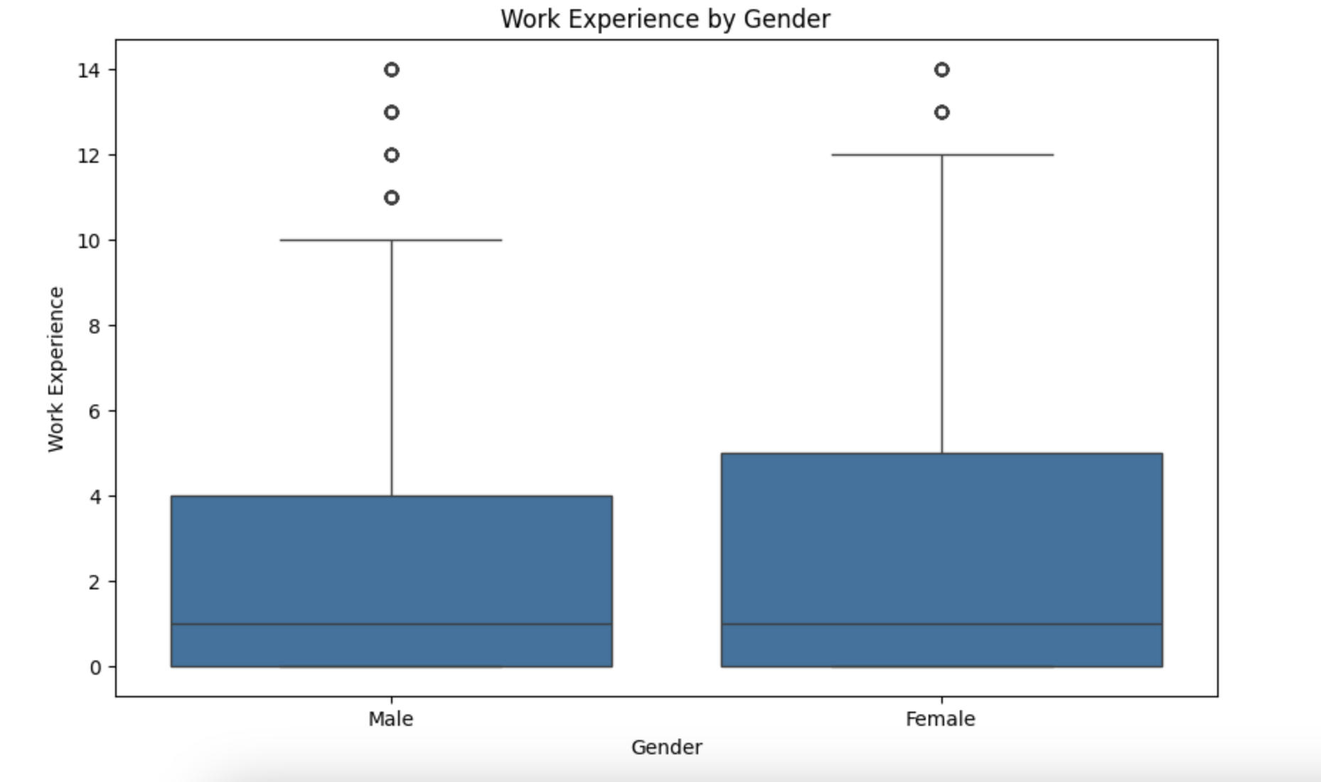
Section II: Descriptive Analysis:
Work Experience by Gender
The chart shows box plots of work experience in years for males and females, allowing for a comparison of median values and outliers between genders.

Slide 13
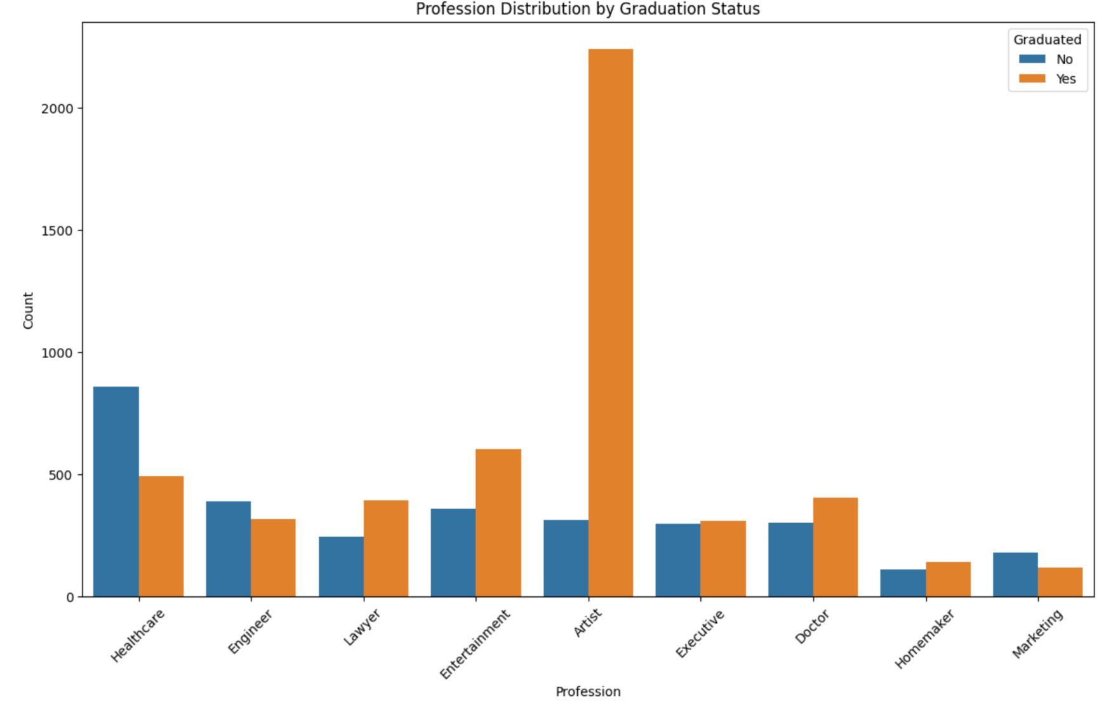
Section II: Descriptive Analysis:
Profession Distribution by Graduation Status
The bar chart shows the number of graduates and non-graduates across various professions like healthcare, engineering, and law. It highlights differences in professional participation relative to educational achievement.

Slide 14
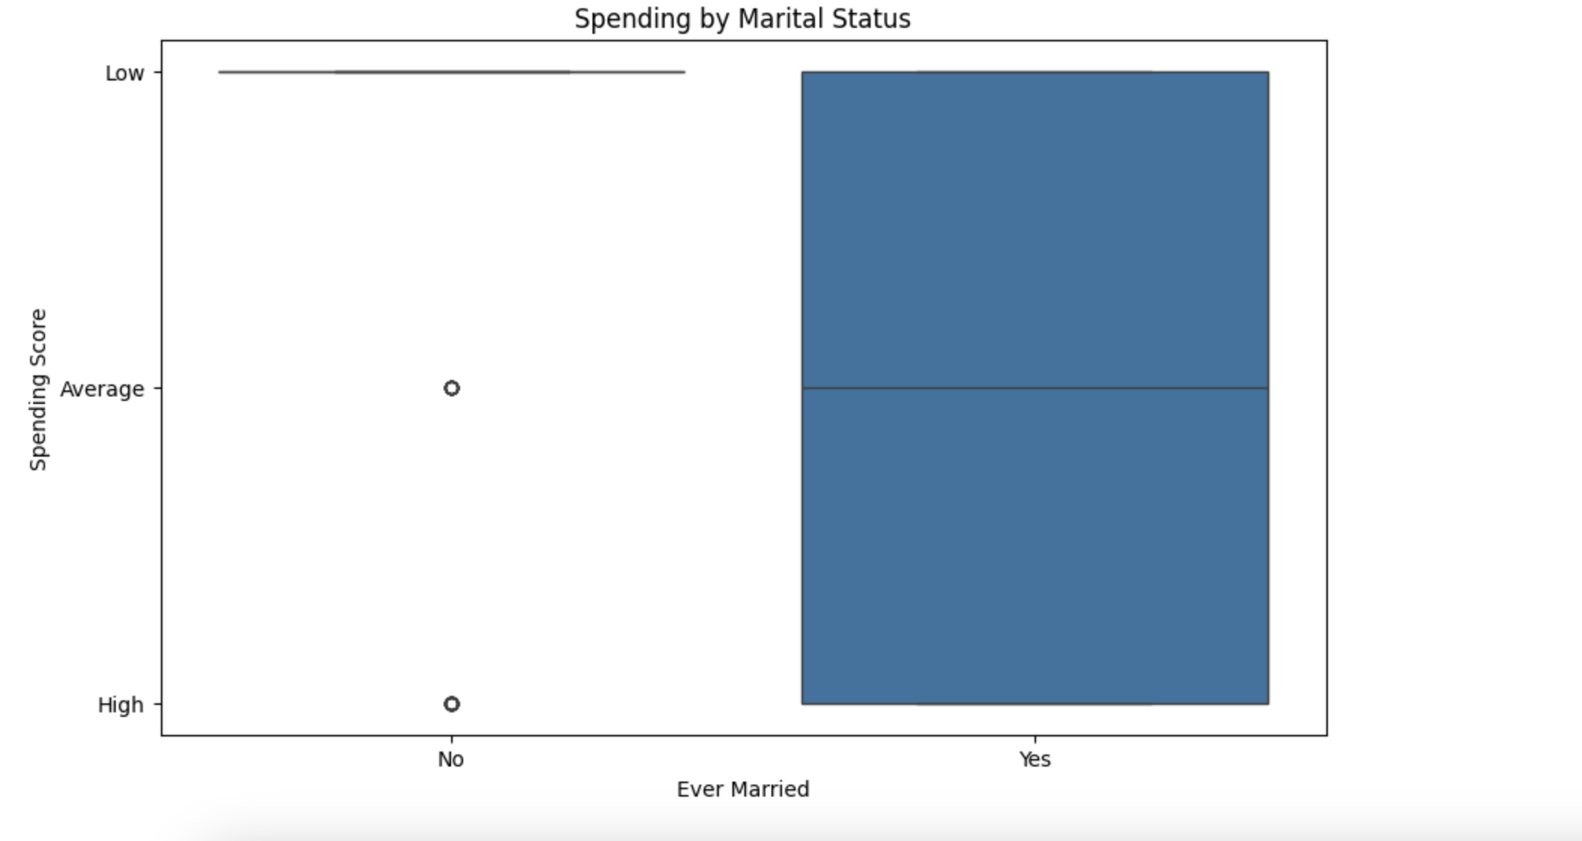
Section II: Descriptive Analysis:
Spending by Marital Status
The chart shows box plots comparing spending scores of individuals who have never married with those who have been married. It highlights differences in spending behaviors and distribution between the two groups.

Slide 15
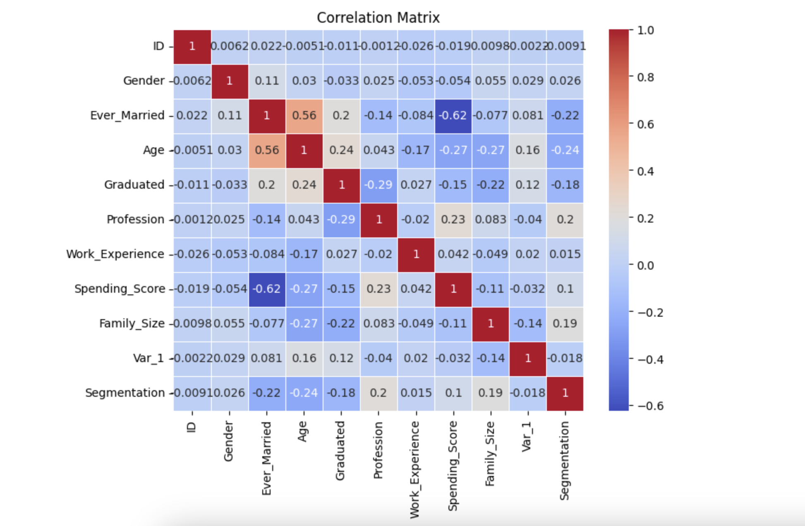
Section II: Descriptive Analysis:
Correlation Matrix
The chart displays a correlation matrix of variables like gender, age, and work experience, among others. It uses a color gradient from red to blue to indicate correlation values from 1 to -1, visually showing the relationships between these factors.

Slide 16
Section III: Model Selection
Predictive Modeling for Spending_Scores
Customer Segmentation Clustering – KMeans
Customer Segmentation Prediction
Feature Importance Analysis

Slide 17
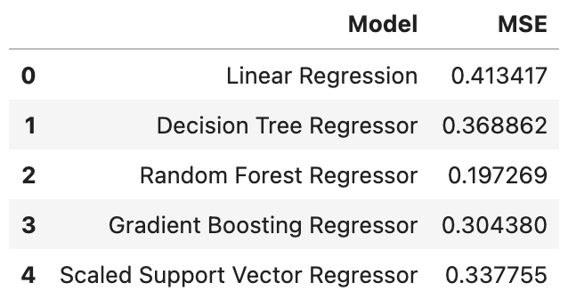
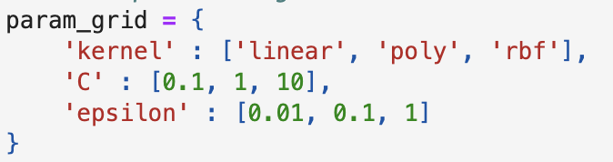
Part 1: Predictive Modeling for Spending Score

Slide 18
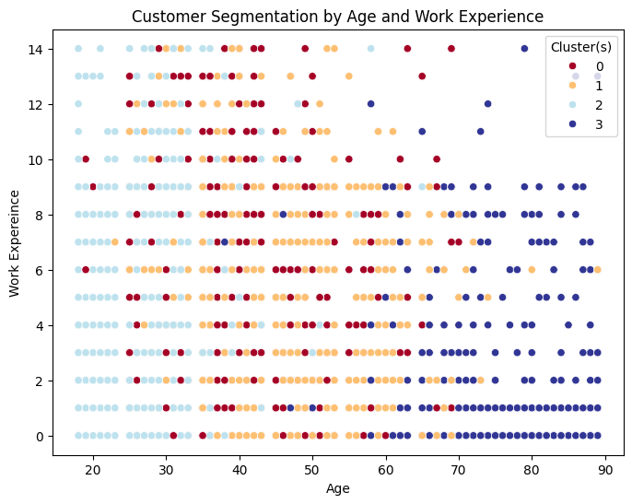
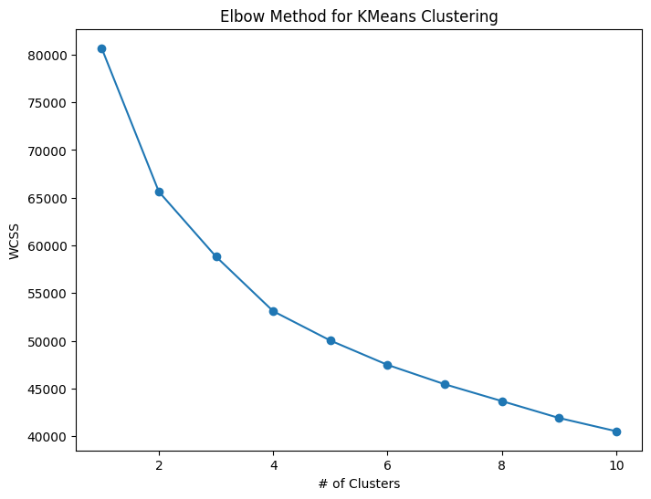
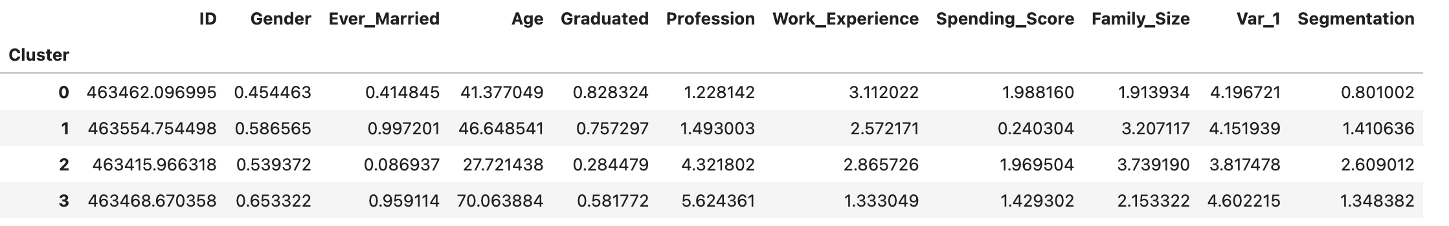
Part 2: Customer Segmentation Clustering - KMeans

Slide 19
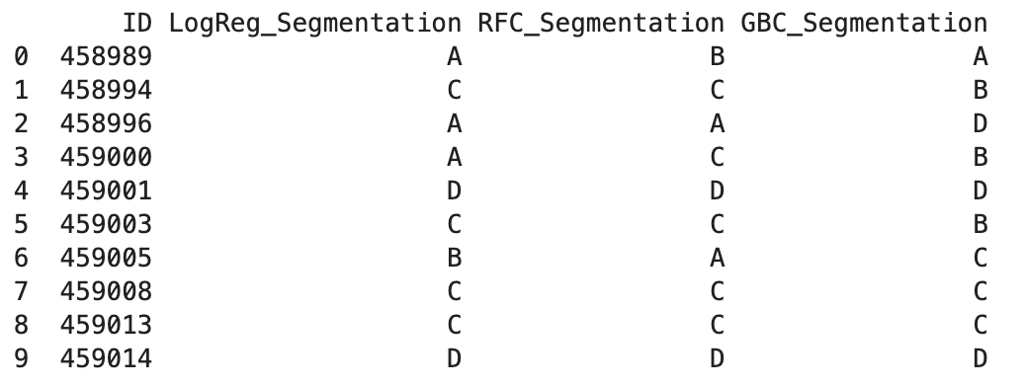
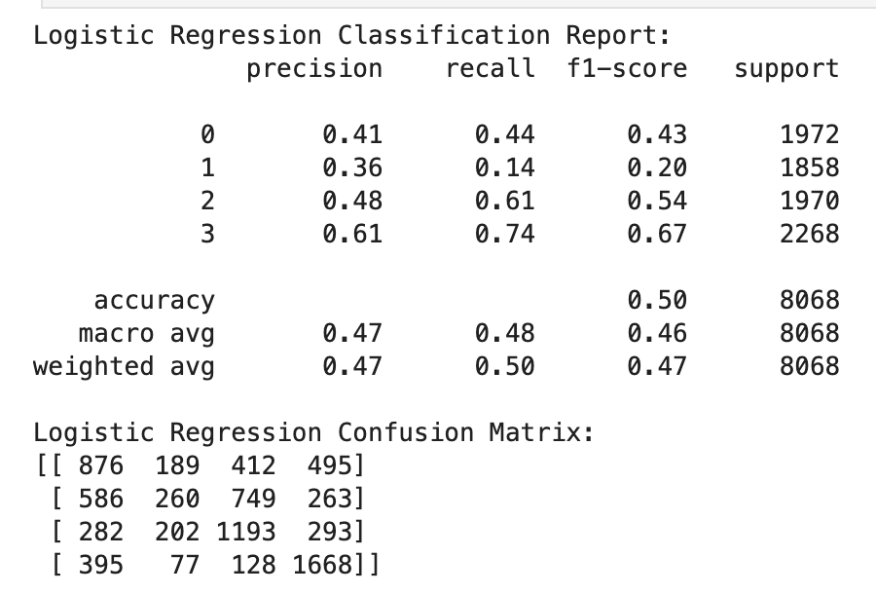
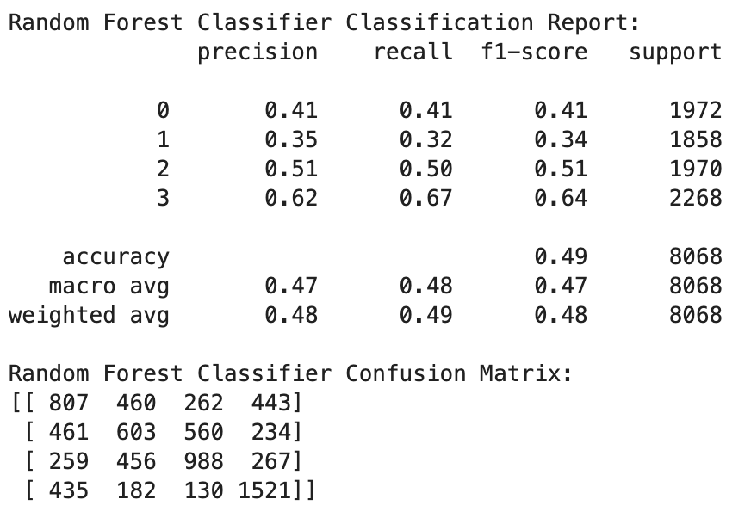
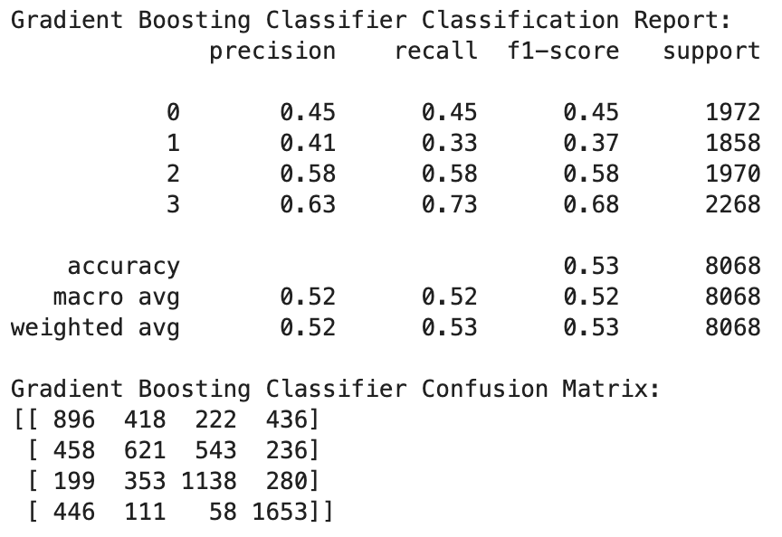
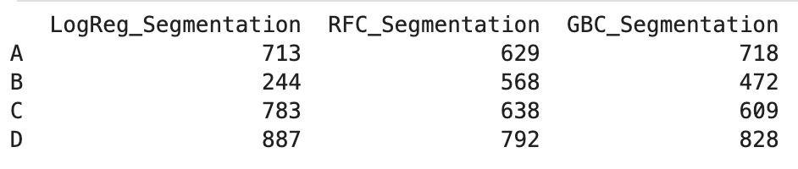
Part 3: Customer Segmentation Prediction
Logistic Regression
Random Forest
Gradient Boosting
Append Prediction to test_data.csv
Notes:
The cross-validation accuracy scores for the three models indicate their performance in predicting customer segments. The Gradient Boosting Classifier achieved the highest cross-validation accuracy score of 0.534, suggesting it has the best predictive power among the three models. The Logistic Regression and Random Forest Classifier had similar but lower accuracy scores of 0.4954 and 0.4857, respectively. This implies that the Gradient Boosting Classifier is the most reliable model for predicting customer segments in this dataset, outperforming the other two models in terms of accuracy. Yet, its accuracy score is too low to say that we are confident the future customer will land in certain segments, only some-what certain.

Slide 20
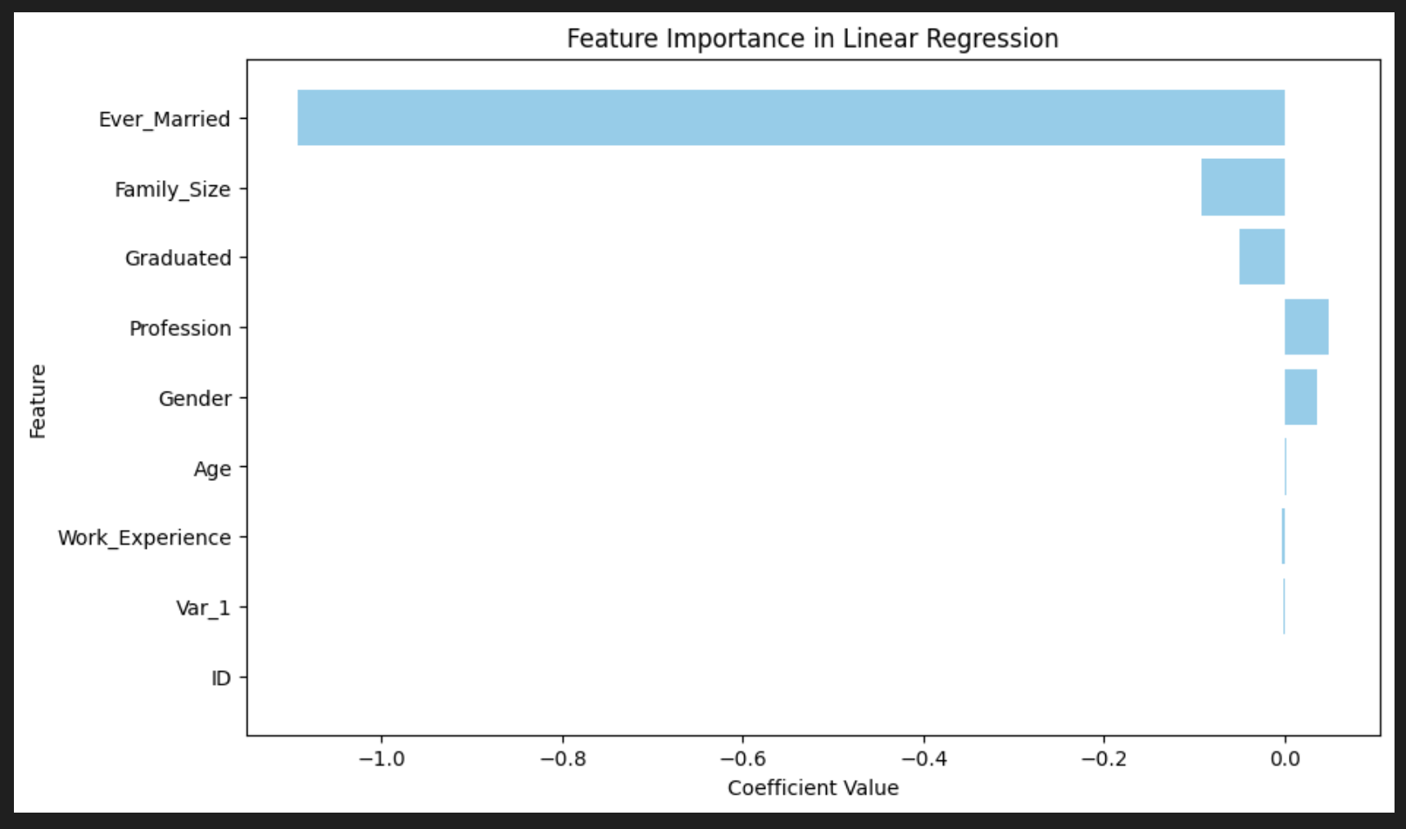
Part 4: Feature Importance Analysis
linear regression

Slide 21
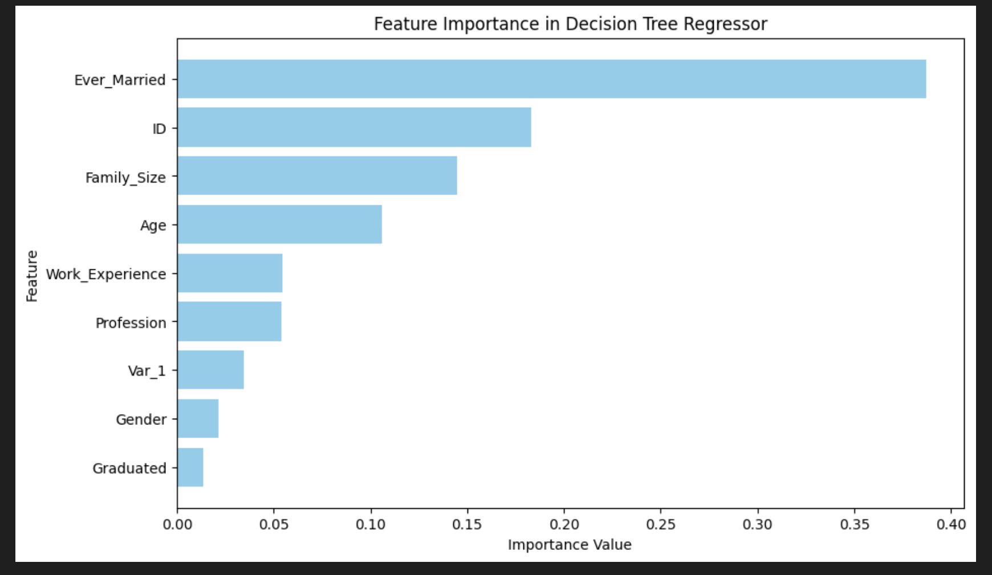
Decision Tree
Part 4: Feature Importance Analysis

Slide 22
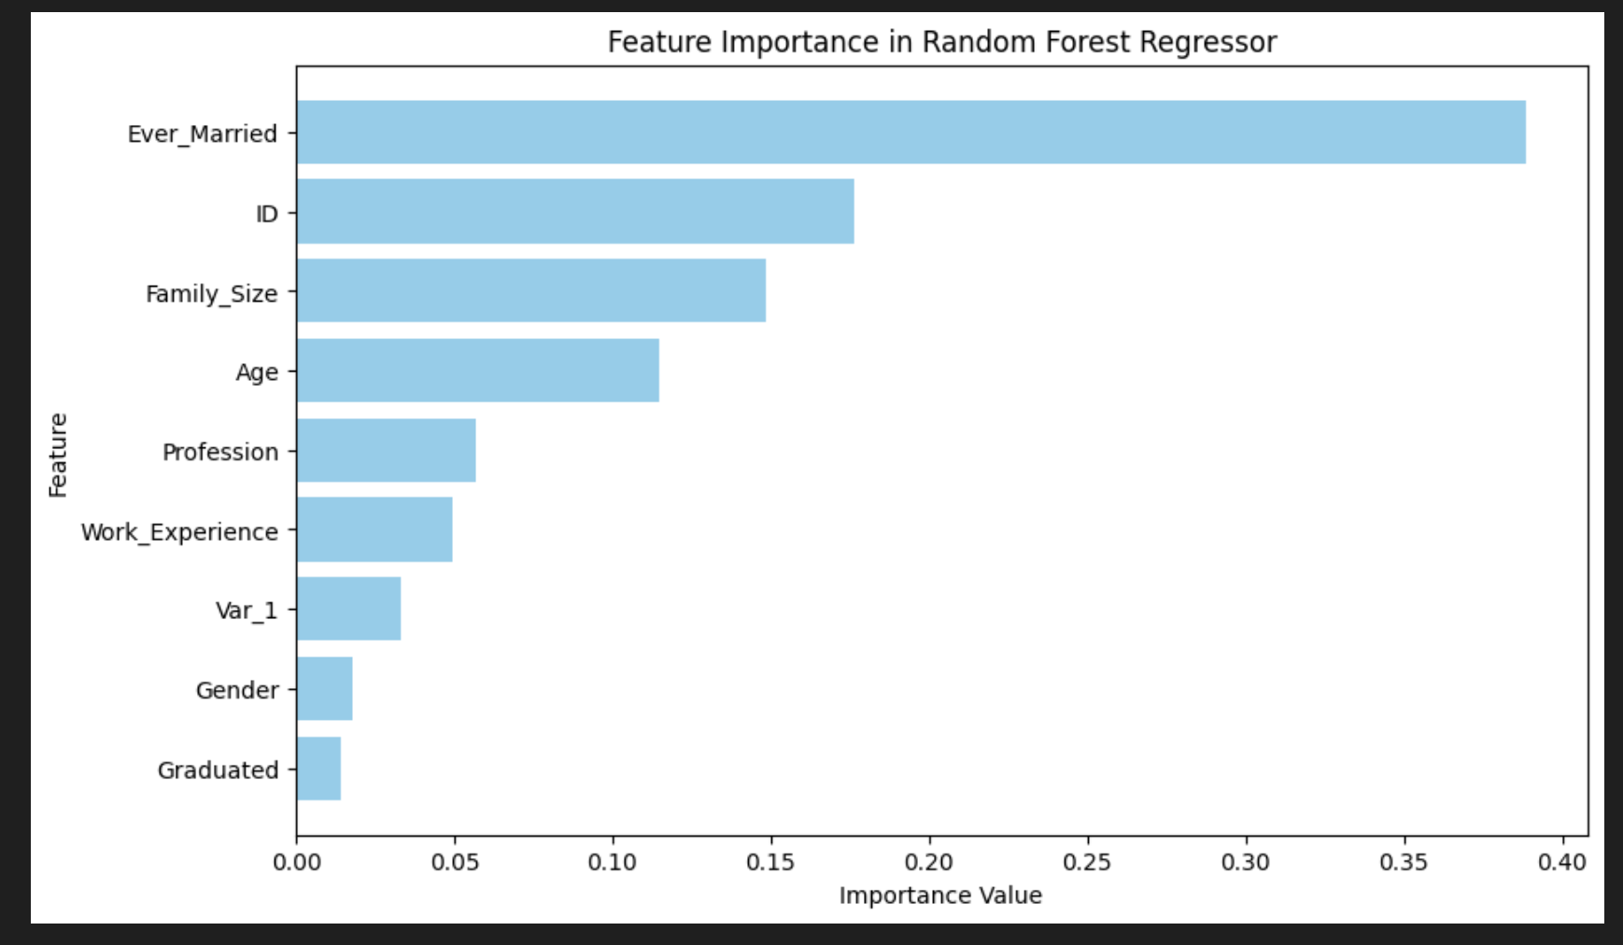
Random Forest
Part 4: Feature Importance Analysis

Slide 23
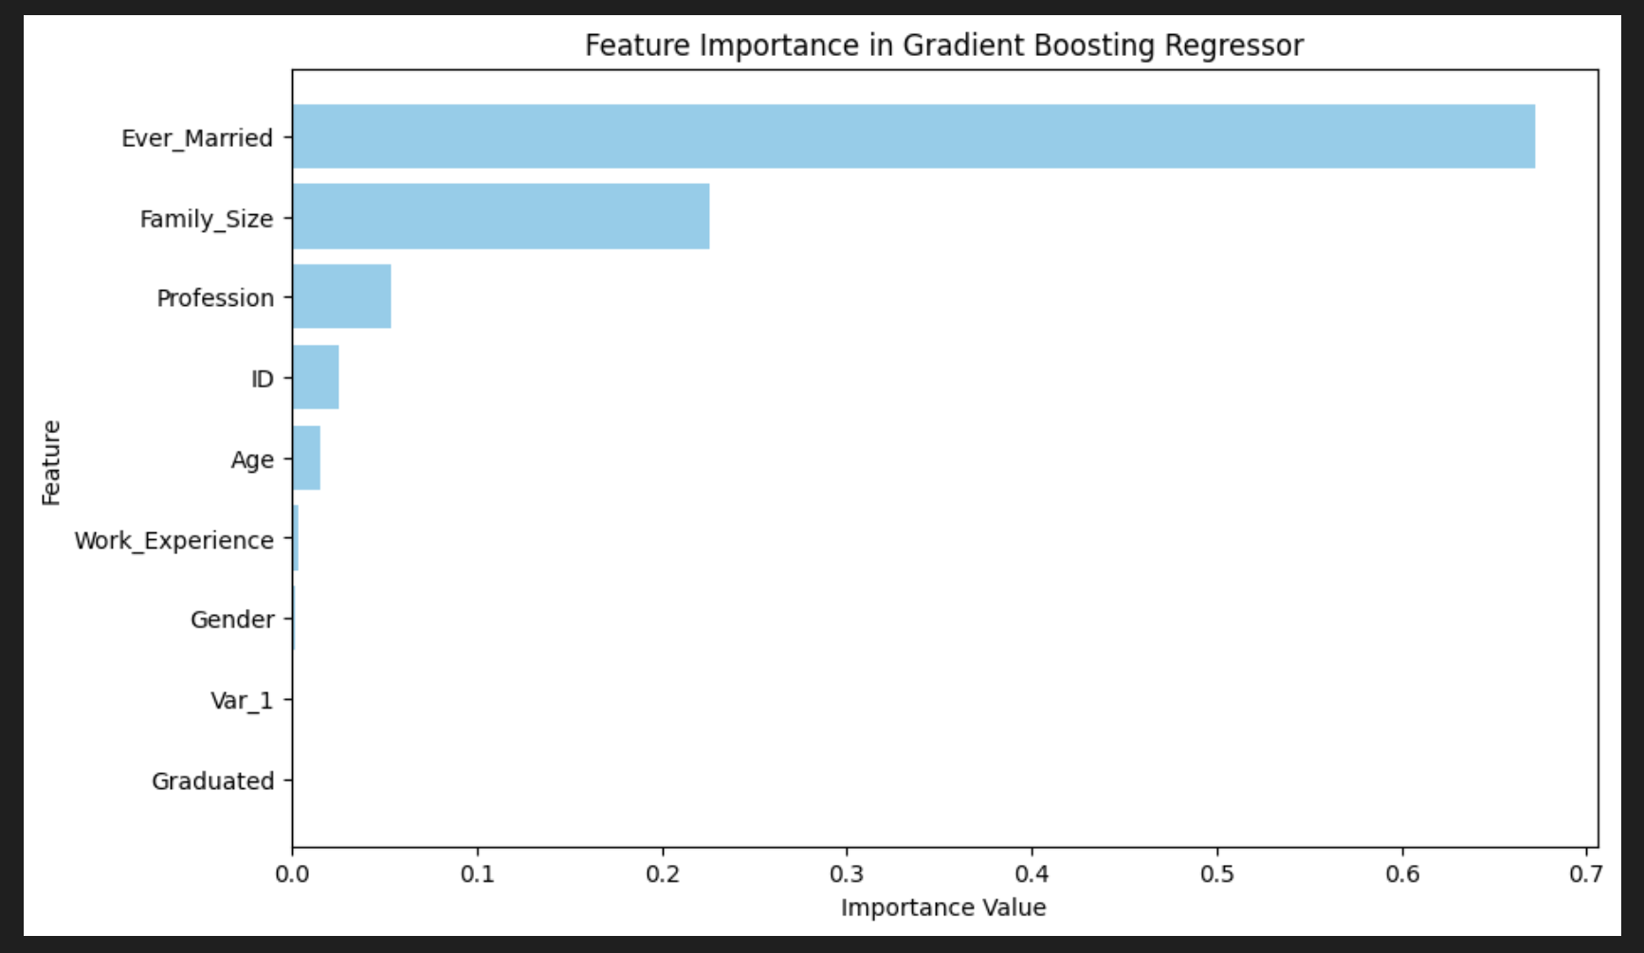
Gradient Boost
Part 4: Feature Importance Analysis

Slide 24

Business Suggestions

Slide 25
Business Suggestions
Targeted Marketing Strategies
Personalized Campaign
- Distinct Characteristics
- Offer and Promote
2. Influential Factors
- Key Predictors
- Optimized by Groups
Model Enhancement
Classification Model
- Additional Features
- trans hist / demo data
2. Continuous Model Training
3. Data-Driven Decision Making
- Use Insights from Pred
- Clustering Analysis

Slide 26
Business Suggestions (cont.)
Customer Engagement and Experience
Enhance Customer Exp.
- Use Seg Analysis to improve and personalize
- Loyalty Program
2. Feedback Mechanisms
- Gather customer opinions and preferences
- Refine customer segments & adjust strategies

Slide 27

Thank you!

